Slide 1

Final project LidlXXX
By Yevhenii Stavytskyi

Slide 2

Introduction
This presentation will explain the Final Project App. This Python program use the PyQt5 library to allow users to buy products with an easy-to-use graphical interface. And of course program use SQL databases the best storage technology.

Slide 3

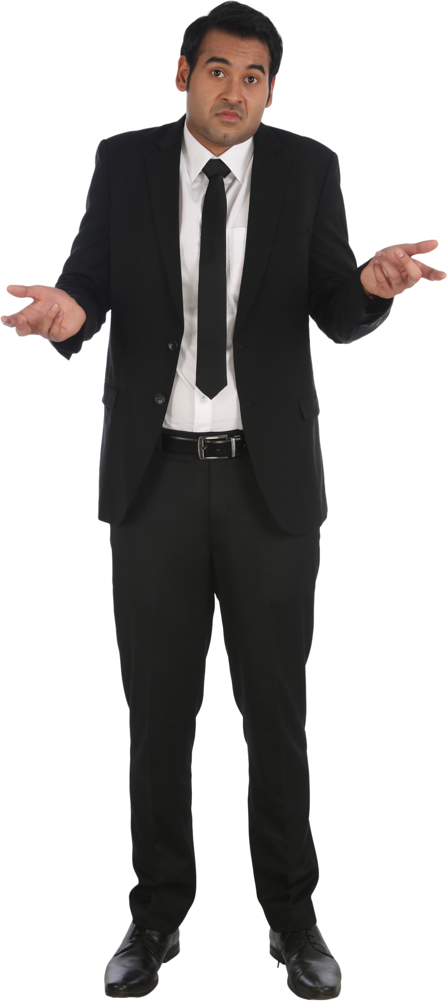
Purpose
The goal of my program is to create a new application for sales and purchases. My early app makes it easy to register, sell and buy. Simple design and good prices for everyone.

Slide 4
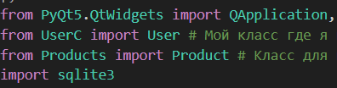
Special Python libraries and our own classes that program use in code:

Slide 5
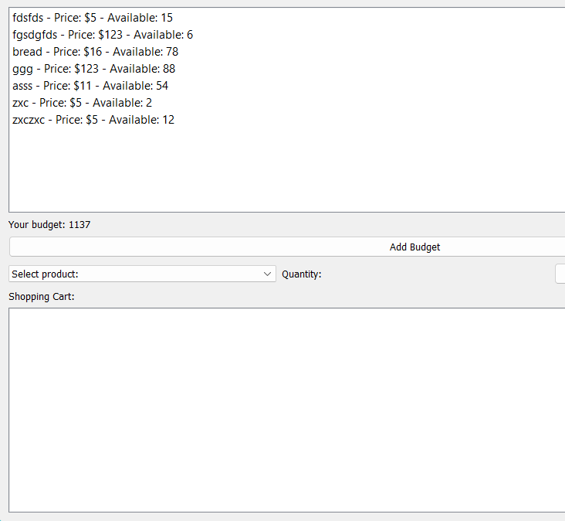
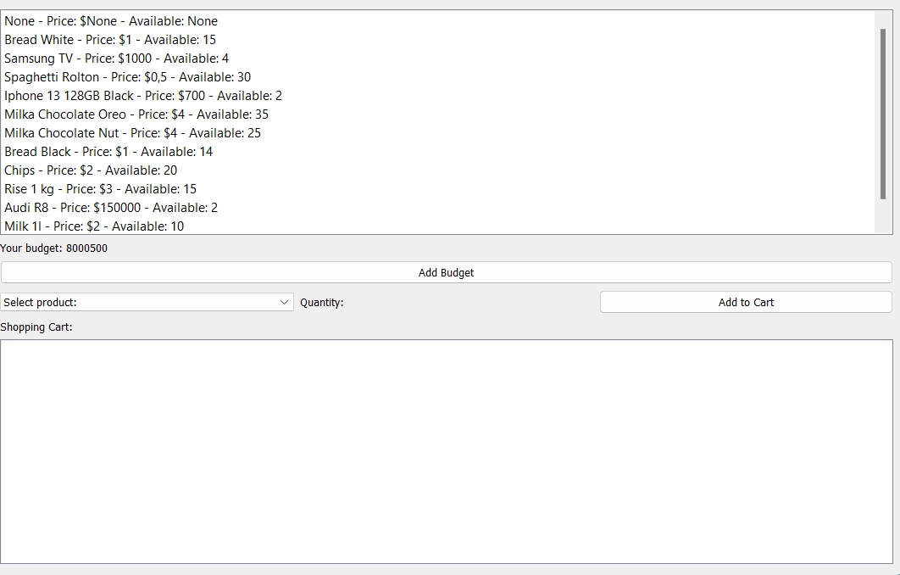
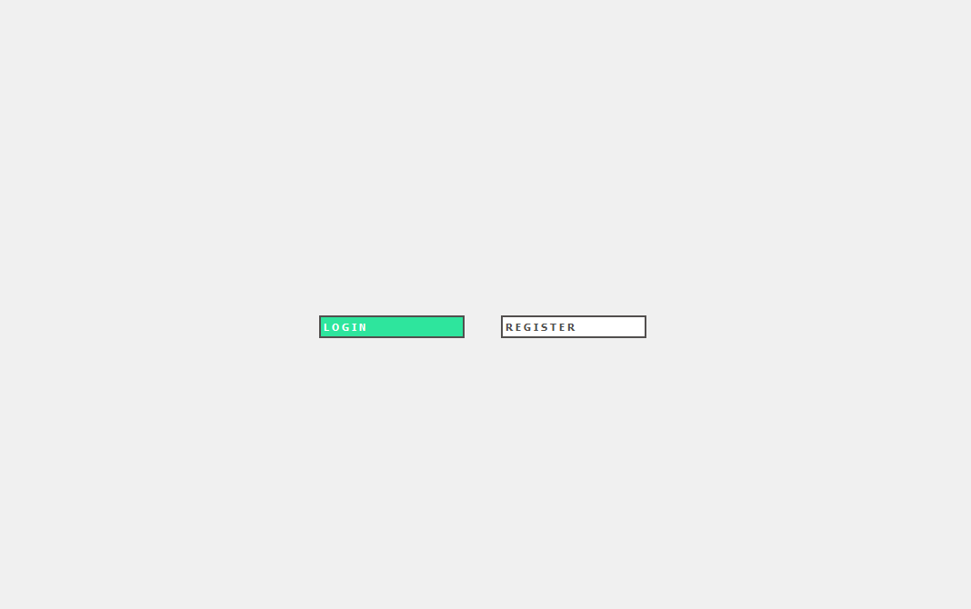
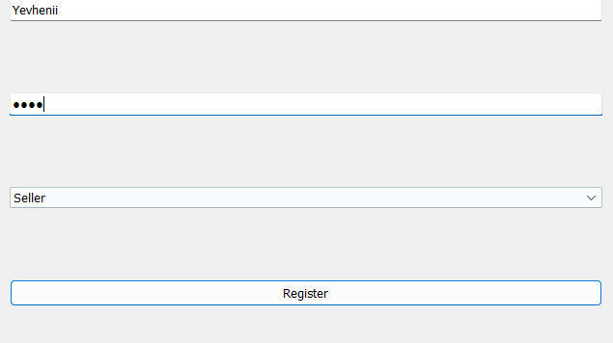
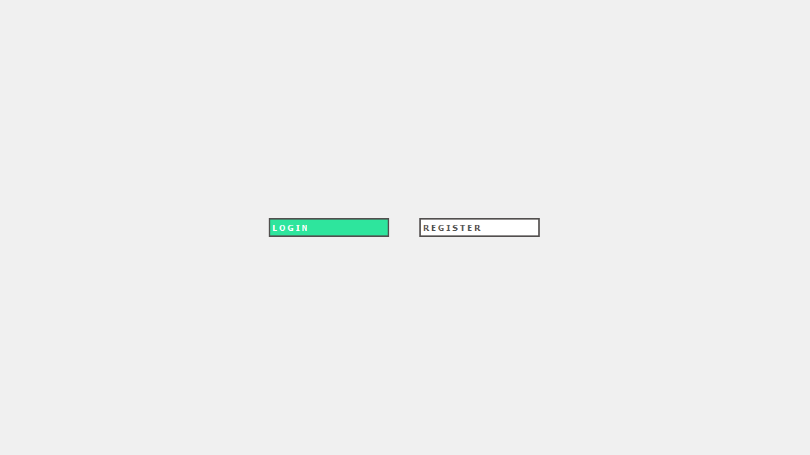
Interface of program is very simple

Slide 6
What can you do?
You can register as a buyer and as a seller
You can also log in
You can add money to your balance/budget and buy products.
You can add products if you are a seller

Slide 7
Conclusion
This program was created for a project at Narva College and has good functionality and a simple design.
Uses many different functions, methods and libraries which shows the full scope of knowledge - and also shows how easy Python is to write simple and useful programs

Slide 8
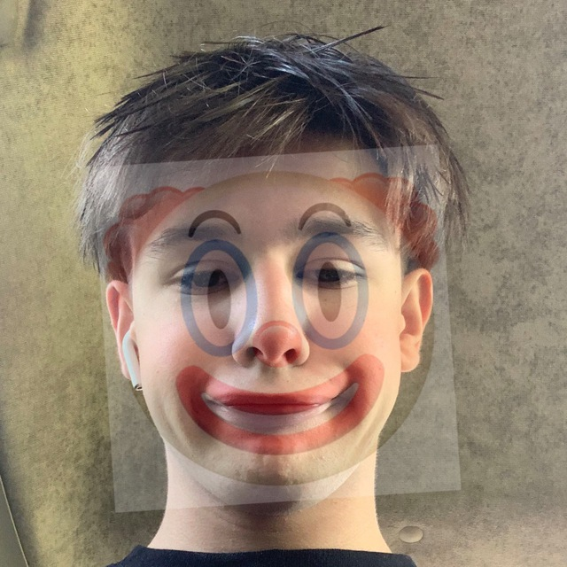
Meet the team of Developer
Yevhenii Stavytskyi
Yevhenii Stavytskyi
Yevhenii Stavytskyi
Yevhenii Stavytskyi
Main developer
Tester
Marketing
Manager
Yevhenii Stavytskyi
Yevhenii Stavytskyi
Yevhenii Stavytskyi
Yevhenii Stavytskyi
VP Product
SEO Strategist
Product Designer
Content Developer

Slide 9

Thank you for your attention!
LidlXXX
Yevhenii Stavytskyi +372 5835 6589

